Slide 1
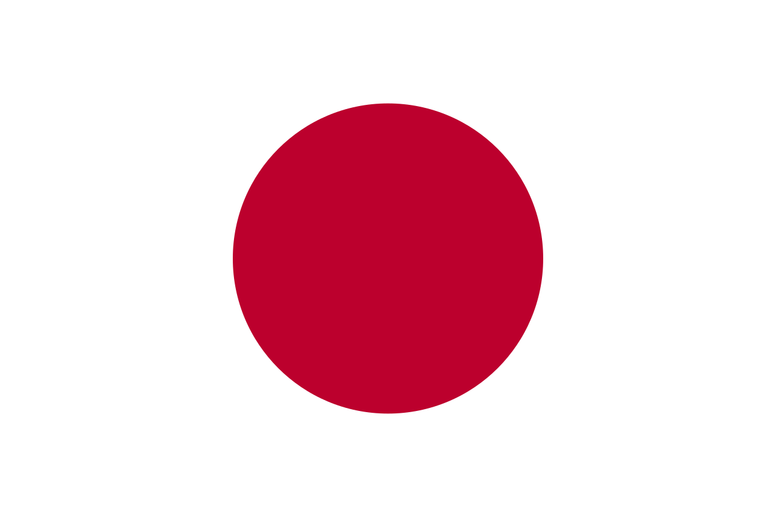
日本 JAPAN
Created by pi18e student
Džiugas pečiulevičius

Slide 2
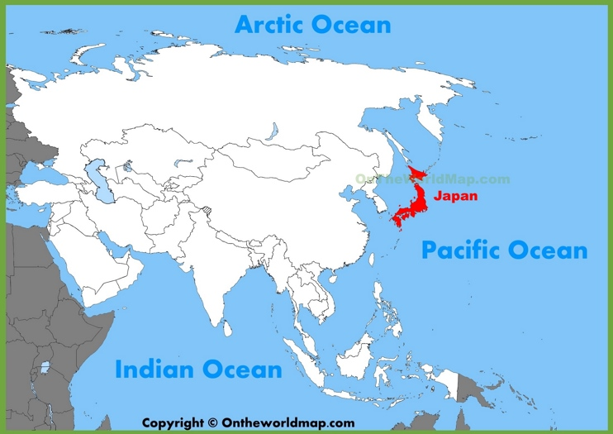
Location
Japan is located in the continent of Asia, Japan covers 364,485 square kilometers of land and 13,430 square kilometers of water, making it the 62nd largest nation in the world with a total area of 377,915 square kilometers.
Japan consists of several thousands of islands, of which Honshu, Hokkaido, Kyushu and Shikoku are the four largest. Japan's closest neighbors are Korea, Russia and China. The Sea of Japan separates the Asian continent from the Japanese archipelago.

Slide 3
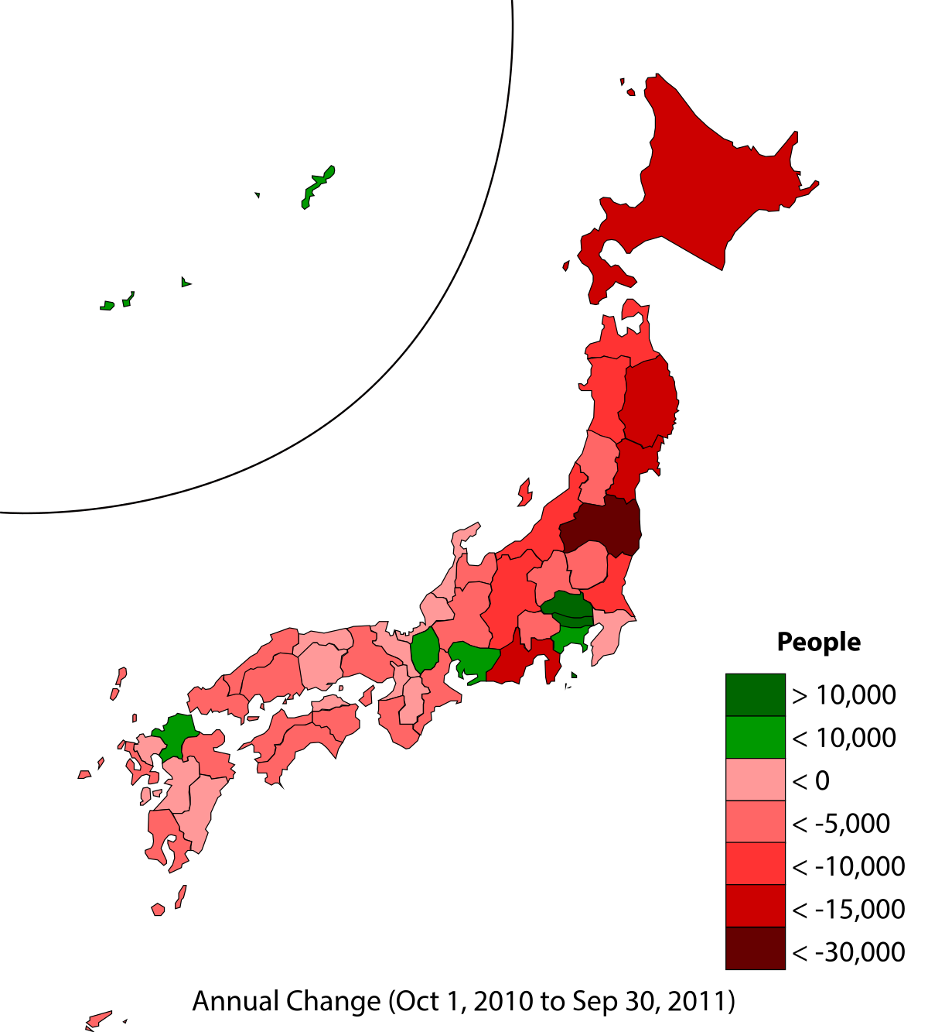
population
The current population of Japan is 126,950,447 as of Sunday, March 17, 2019, based on the latest United Nations estimates.
Japan population is equivalent to 1.64% of the total world population.
Japan ranks number 11 in the list of countries (and dependencies) by population.
The population density in Japan is 348 per Km² (901 people per mi²).
The total land area is 364,555 Km2 (140,755 sq. miles)
94.1 % of the population is urban (119,420,037 people in 2019)
The median age in Japan is 46.7 years.

Slide 4
religion
The statistic shows religion membership in Japan as of 2017. That year, 79.2 percent of the total population of Japan participate in Shinto practices.

Slide 5
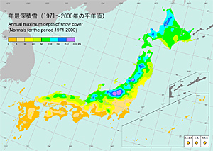
climate
Spring is from March to May. Temperatures are warm but not too hot, plus there isn’t too much rain. The famous cherry blossoms are out during this time.
Summer begins in June and the country experiences a three to four-week rainy season during which the farmers plant their rice. It is hot and humid during this time and temperatures are often in the high 30’s. Summer wraps up in August.

Slide 6
climate
Autumn is from September to November and is characterized by light breezes and cooler temperatures of around 8-10ºC. It’s during autumn that many exhibitions, music concerts and sports tournaments are held in Japan.
Japan's weather in Winter, from December to February, is quite dry and sunny along the Pacific coast and the temperatures rarely drop below 0°C. The temperatures drop as you move north, with the Central and Northern regions experiencing snowfall. Southern Japan is relatively temperate and experiences a mild winter.

Slide 7
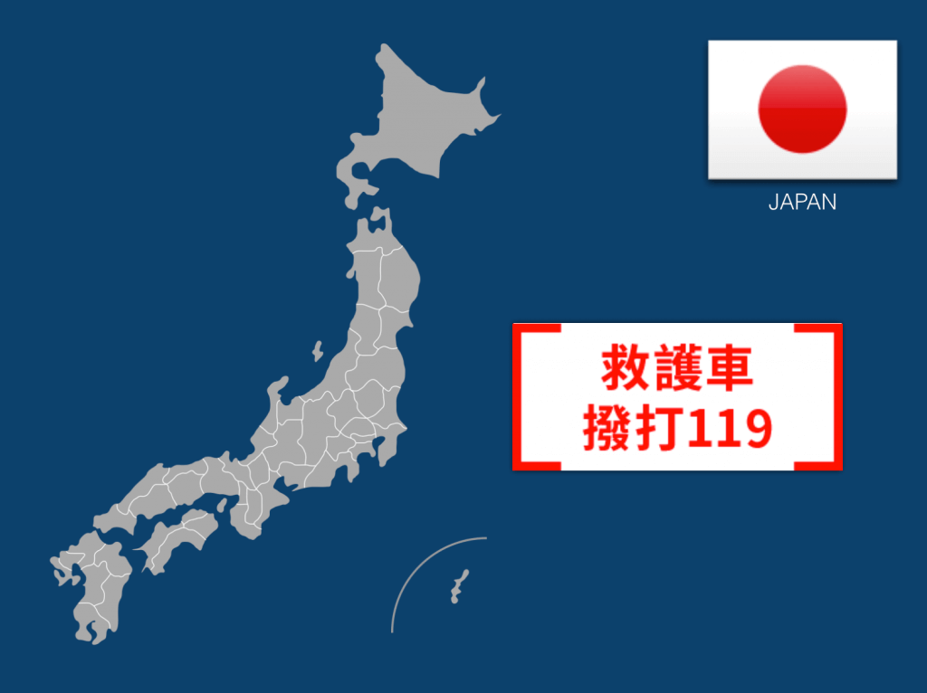
Possible emergencies
A major earthquake with a magnitude of between 7 and 8 is highly likely in most undersea areas along the Japan Trench off eastern Japan within the next 30 years.
The government’s Earthquake Research Committee classified as category 3 most undersea areas along the trench, which sits off the Pacific coast from Aomori Prefecture to Ibaraki Prefecture. The classification means the probability of such a major quake is estimated to be 26 percent or higher over the period.
“The possibility of a quake with a magnitude of up to around 8 along the trench remains high,” said Naoshi Hirata, chairman of the committee.

Slide 8
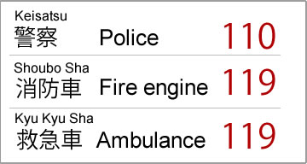
EMERGENCY PHONE NUMBERS

Slide 9
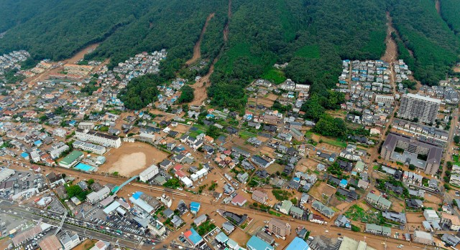
emergencies in past 5 years
Hiroshima landslides on 20 August 2014,
Mount Ontake eruption on September 27, 2014,
Ogasawara-shoto Seihō Oki Jishin (Bonin Islands) on May 30, 2015,
Kumamoto earthquakes on April 14 and 16, 2016
Fukushima earthquake on November 22, 2016
Osaka earthquake on June 18, 2018
Hokkaido Eastern Iburi earthquake on 6 September 2018.

Slide 10
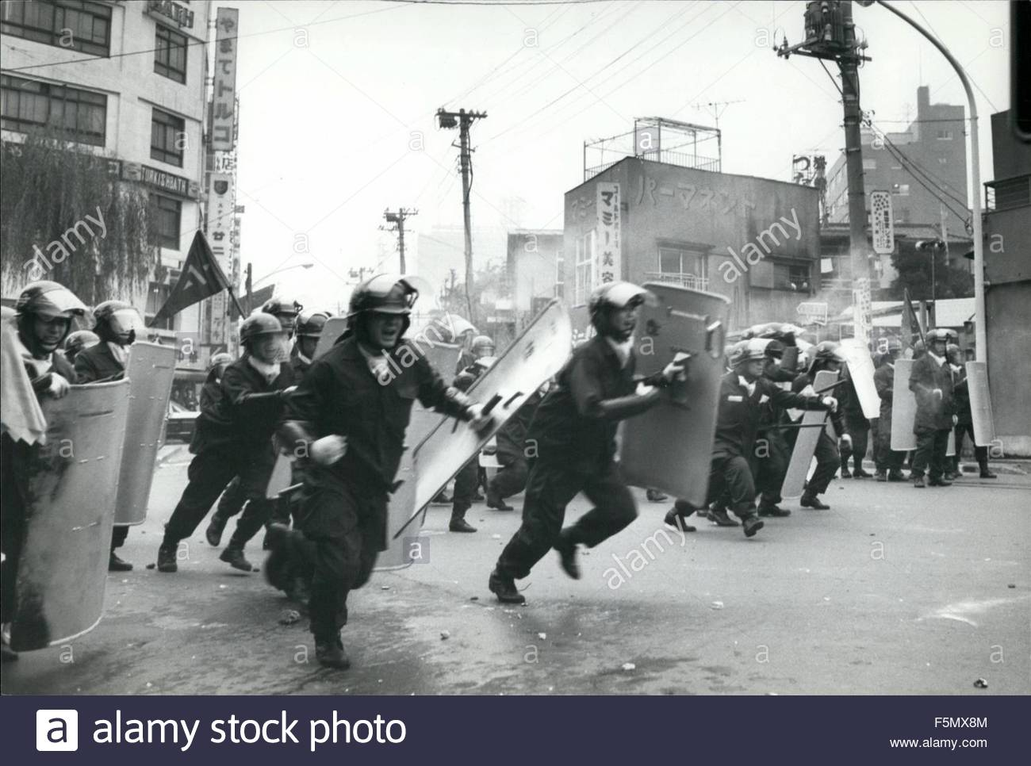
SOCIAL DISASTERS Riots
The Era of Popular Violence is a period of modern Japanese history from 1905–1918 that consisted of a series of violent protests (nine different riots in Tokyo alone). The period is considered to have started after the Hibiya Incendiary Incident and culminated in the Rice riots of 1918.
The Kakitsu uprising was a peasant uprising demanding debt cancellation that occurred in 1441, the 1st year of Kakitsu, in Kyoto and surrounding areas such as Ōmi Province.

Slide 11
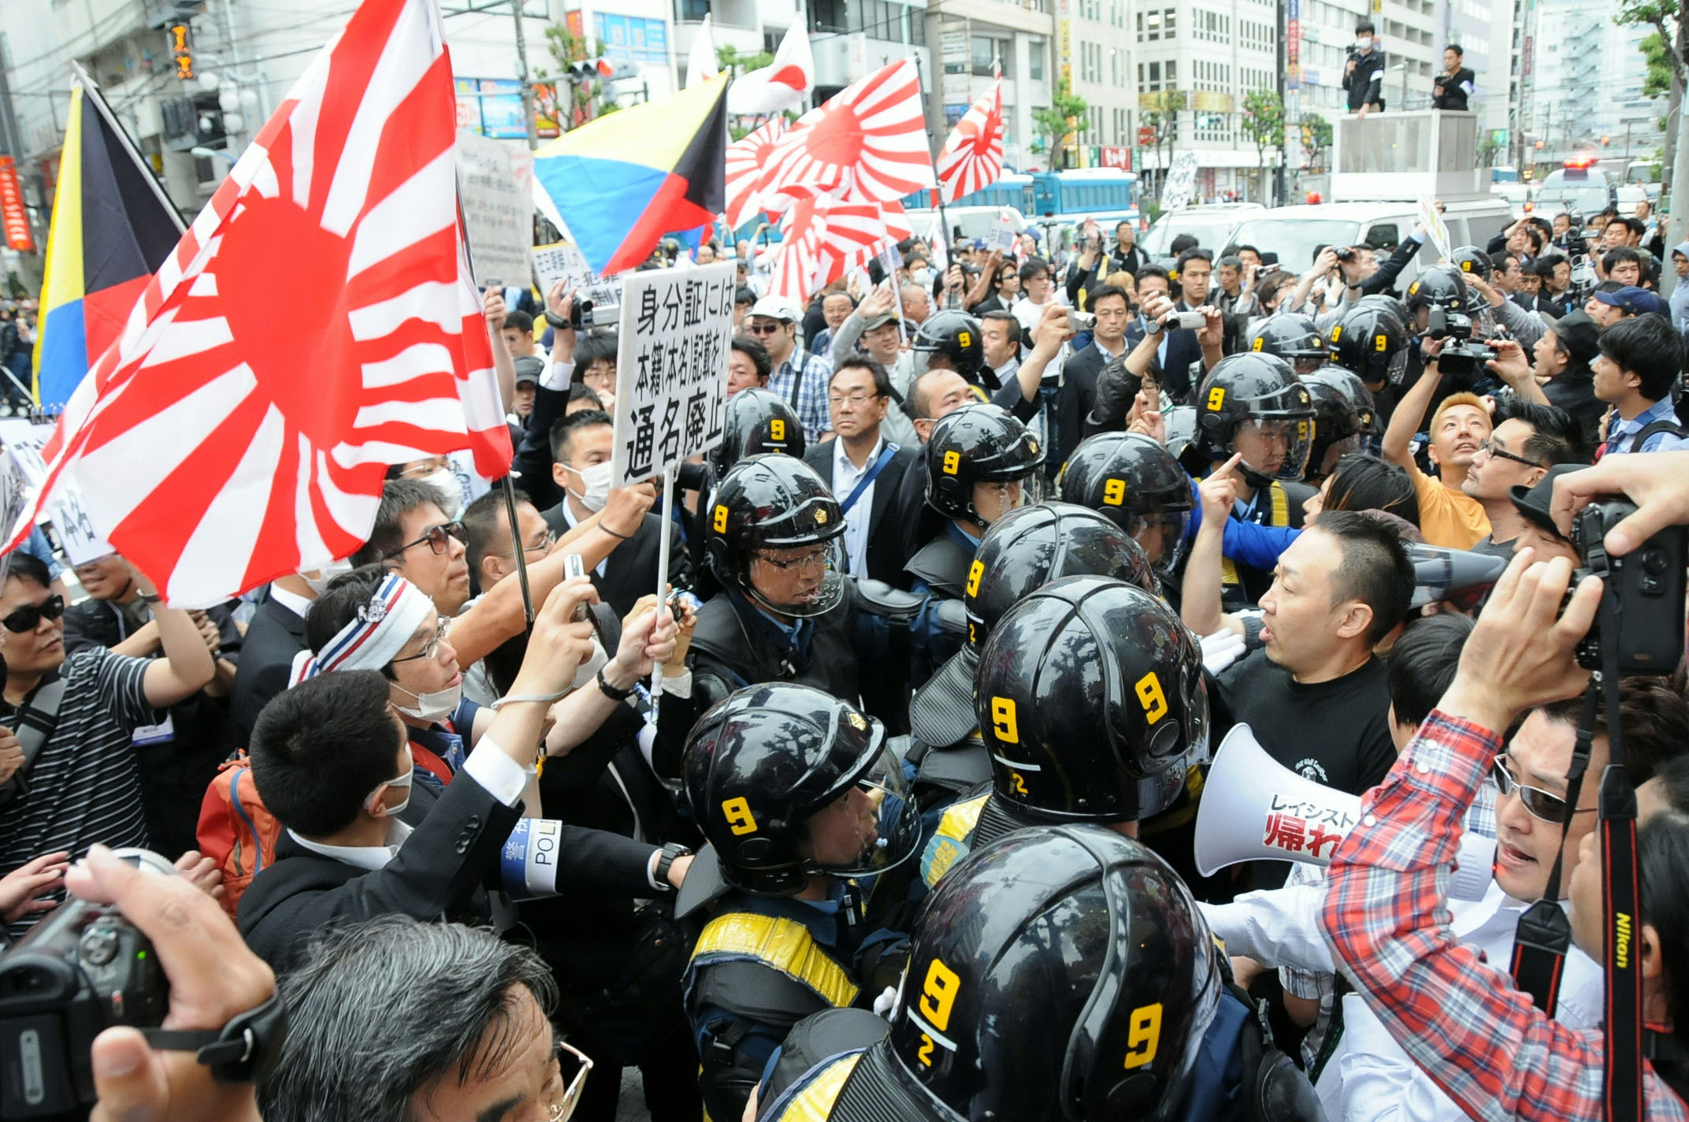
SOCIAL DISASTERS riots
The Koza riot was a violent and spontaneous protest against the US military presence in Okinawa, which occurred on the night of December 20, 1970, into the morning of the following day. Roughly 5,000 Okinawans clashed with roughly 700 American MPs in an event which has been regarded as symbolic of Okinawan anger against 25 years of US military occupation. In the riot, approximately 60 Americans were injured, 80 cars were burned, and several buildings on Kadena Air Base were destroyed or heavily damaged.

Slide 12
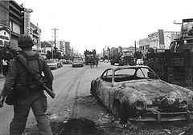
SOCIAL DISASTERS riots
The Nagasaki incident, also known as the Nagasaki―Qing Navy Incident, was a riot involving Chinese Beiyang Fleet sailors in Nagasaki.
The rice riots of 1918 were a series of popular disturbances that erupted throughout Japan from July to September 1918, which brought about the collapse of the Terauchi Masatake administration.
The Shōchō uprising was one of the many armed rebellions in Japan during the Muromachi Period and the first launched by the peasants. It occurred between August and September of the year 1428, which in the old Japanese calendar was the 1st year of Shōchō, and is also known as the Shōchō no Tokusei Ikki, the Shocho debt cancellation revolt.

Slide 13
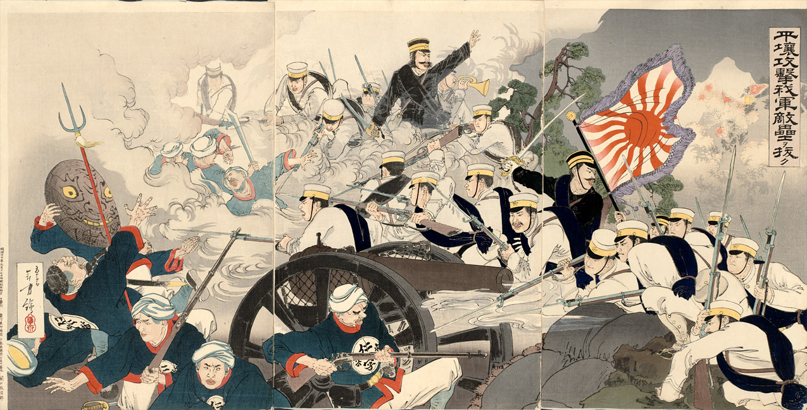
SOCIAL DISASTERS wars
WORLD WAR I (1914–1918)
Siberian Intervention (1918–1922)
Japanese invasion of Manchuria (1931–1932)
Second Sino-Japanese War (1937–1945)
Invasion of French Indochina (1940)
WORLD WAR II (1941–1945)
Battle of Amami-Ōshima (2001)
Iraq War (2003–2011)
Operation Ocean Shield (2009–2016)

Slide 14
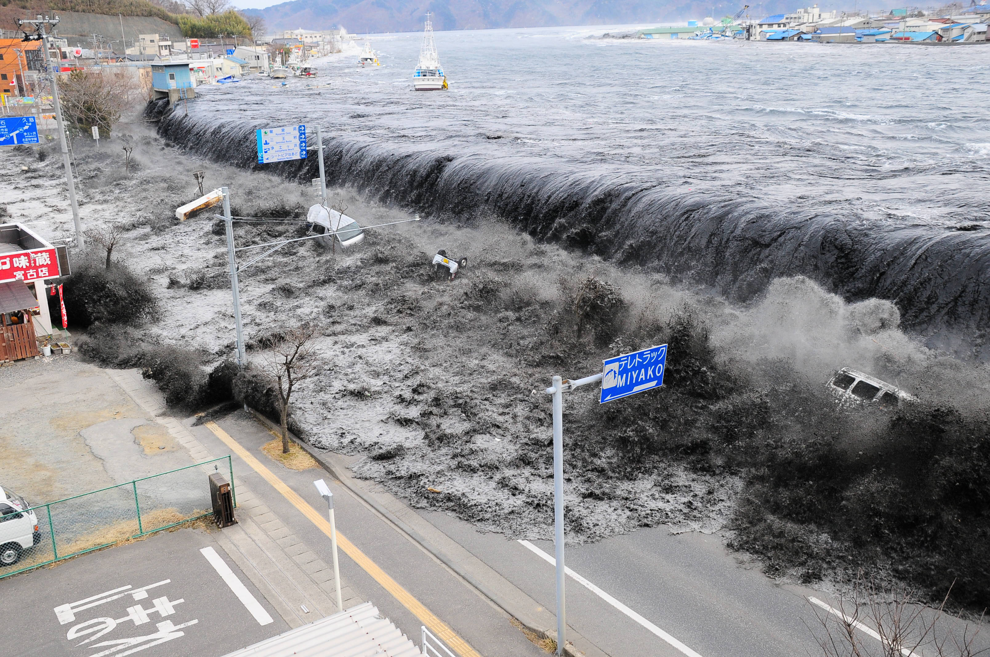
Ecological disasters
On 30 September, 1999 The Japanese Tokaimura nuclear power plant workers mistakenly blended uranium. Three of them were deadly burned, hundreds of people were turned into radiation.
The people of Minamata, Japan, were surprised by the strange behavior of cats. Covered by convulsions, they jumped into the water and died. 1956 the first person became ill with this disease. Later it turned out that its source was the water contaminated by the chemicals in Minamat Bay.

Slide 15
Natural types of disasters
Tsunamis,
Floods,
Typhoons,
Earthquakes,
Cyclones,
Volcanic eruptions,
Hailstorms,
Tornadoes,
Thunderstorms,
Lightnings,
Nuclear explosions
And other natural disasters including the related geotectonic phenomena.

Slide 16
NATURAL DISASTERS IN THE PAST 5 YEARS
2018 Japan floods
2018 Hokkaido Eastern Iburi earthquake
2018 Osaka earthquake
2016 Kumamoto earthquakes
2014 Hiroshima landslides
2014 Mount Ontake eruption

Slide 17
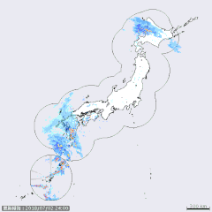
2018 JAPAN FLOODS
In late June through mid-July 2018, successive heavy downpours in southwestern Japan resulted in widespread, devastating floods and mudflows. The event is officially referred to as "Heavy rain of July, Heisei 30") by the Japan Meteorological Agency. As of 20 July, 225 people were confirmed dead across 15 prefectures with a further 13 people reported missing. More than 8 million people were advised or urged to evacuate across 23 prefectures. It is the deadliest freshwater flood-related disaster in the country since the 1982 Nagasaki flood when 299 people died.
Approximately 54,000 members of the Japan Self-Defense Forces, police and firefighters have been searching for the people trapped or injured in landslides and flooding triggered by the heavy rain, while the Japanese government has set up a liaison unit at the crisis management center of the prime minister's office to gather information.

Slide 18
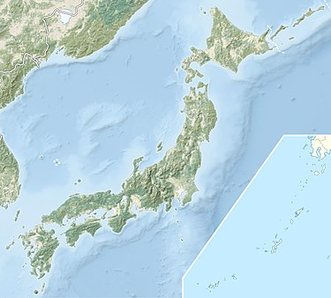
2018 Hokkaido Eastern Iburi earthquake
An earthquake measuring 6.6 M_{W} on the moment magnitude scale struck Iburi Subprefecture in southern Hokkaido, Japan, on 6 September 2018 at 3:08 a.m. Japan Standard Time. The earthquake's epicenter was near Tomakomai and occurred at a depth of 35.0 kilometres (21.7 mi). The Japan Meteorological Agency(JMA) registered a magnitude of 6.7 M_{j} and a maximum intensity of 7 on the shindo scale. Shaking from the earthquake was felt strongly in Hokkaido and Aomori Prefecture, and shaking was felt as far away as the Kantō region.The earthquake disrupted electrical service throughout Hokkaido, leaving 5.3 million residents without power. Forty-one people were confirmed dead and six hundred and ninety-one were injured.

Slide 19

2018 Osaka earthquake
On 18 June 2018, around 7:58 a.m. Japan Standard Time, an earthquake measuring 5.5 Mw on the moment magnitude scale struck in northern Osaka Prefecture, Japan. The earthquake's epicenter was near Takatsuki and occurred at a depth of 13.2 kilometres (8.2 mi). The Japan Meteorological Agency registered a magnitude of 6.1 Mj and an intensity of lower 6 on the shindo scale.
Shaking from the earthquake was felt strongly in the prefecture and the nearby metropolitan areas of Osaka and Kyoto, temporarily disrupting electrical and gas service to 170,000 homes and buildings. The earthquake struck during rush hour, disrupting train services for several hours, and also damaged water pipes and hundreds of homes. At least four people have been killed and 417 people have reported injuries.

Slide 20
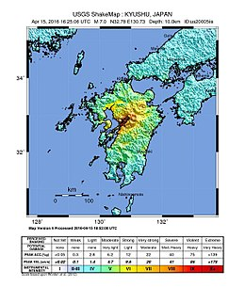
2016 Kumamoto earthquakes
The 2016 Kumamoto earthquakes are a series of earthquakes,including a magnitude 7.0 mainshock which struck at 01:25 JST on April 16, 2016 (16:25 UTC on April 15) beneath Kumamoto City of Kumamoto Prefecture in Kyushu Region, Japan, at a depth of about 10 kilometres (6.2 mi),and a foreshock earthquake with a magnitude 6.2 at 21:26 JST (12:26 UTC) on April 14, 2016, at a depth of about 11 kilometres (6.8 mi).
The two earthquakes killed at least 50 people and injured about 3,000 others in total. Severe damage occurred in Kumamoto and Ōita Prefectures, with numerous structures collapsing and catching fire. More than 44,000 people were evacuated from their homes due to the disaster.

Slide 21
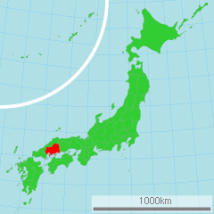
2014 Hiroshima landslides
On 20 August 2014, Hiroshima Prefecture in Japan was struck by a series of landslides following heavy rain. Seventy-four people were reported dead. According to the police, the dead included three boys aged two, three and eleven

Slide 22
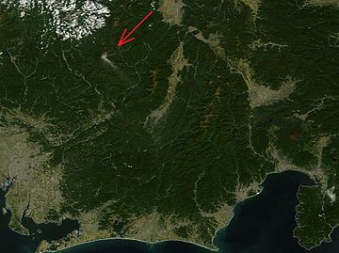
2014 Mount Ontake eruption
A volcanic eruption of Mount Ontake took place on September 27, 2014, killing 63 people. Mount Ontake is a volcano located on the Japanese island of Honshu around 100 kilometres northeast of Nagoya and around 200 km West of Tokyo. It was the first fatal volcanic eruption in Japan since the 1991 collapse of a lava dome at Mount Unzen, and the deadliest volcanic eruption in Japan since Torishima killed an estimated 150 people in 1902.

Slide 23
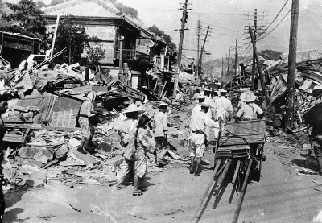
“BIGGEST” NATURAL disasters Great Kantō earthquake, 1923
The quake struck the Kantō Plain on the Japanese main island of Honshu at 11:58 AM JST, on Saturday, September 1st, 1923. The duration of the earthquake indicated by various accounts was between a whooping four to 10 minutes. This was perhaps the deadliest earthquake in Japanese history, and at that time was recorded as the most powerful earthquake that hit the region measuring at a magnitude of 7.9 which was however, surpassed later by a quake of magnitude 9.0. For a country that faces around 5000 recorded quakes every year, the Great Kantō earthquake was surely one that left a deep scar, as an estimated 200,000 people were killed and over half a million houses were destroyed by fire storms that were caused after the quake. The quake also gave rise to tsunami with waves up to 10 m (33 ft) in the Sangami Bay and Izu Islands region.

Slide 24
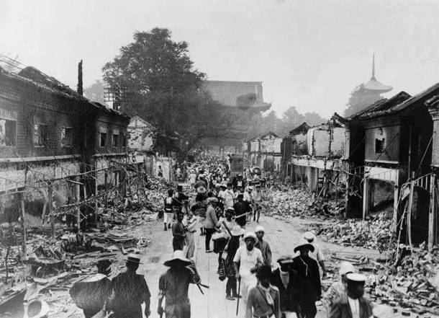
“BIGGEST” NATURAL disasters Nankaidō earthquake, 1946
On 21 December, 1946 a catastrophic earthquake hit the southwest of Japan in the Nankai Trough measuring a whooping 8.4 on the moment magnitude scale. The time was exactly 4:20 local time and the quake was reported to be one of the Nankai’s mega-thrust earthquakes which are periodic quakes occurring off the southern coast of Kii Peninsula and Shikoku, Japan every 100 to 150 years. The quake gave rise to enormous tsunami waves that washed away 1451 houses and caused over a 1500 deaths. The quake felt almost everywhere in the central and western parts of the country, making it one of the most powerful earthquakes ever to have occurred in Japan.

Slide 25
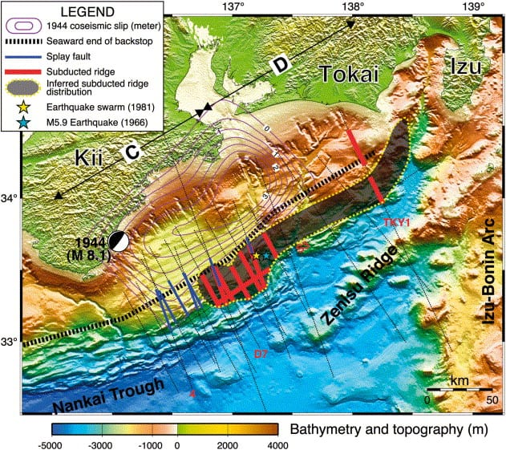
“BIGGEST” NATURAL disasters Tonankai earthquake, 1944
The earthquake hit the Pacific coast of central Japan on 7th December, 1944, about 20 km off the Shima Peninsula in Japan, mainly striking coastal areas like Mie, Aichi and Shizuoka Prefectures. As the result of the ongoing Second War at the time, the news on the event was downplayed by the authorities in order to protect wartime morale, and as a result the full extent of the damage was never known. However, it was estimated that the quake had killed over 1300 people, the tsunami waves being the leading cause of the casualties.

Slide 26
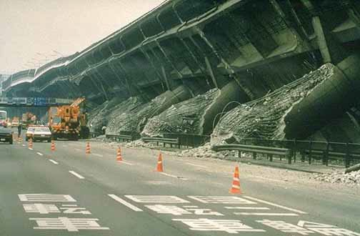
“BIGGEST” NATURAL disasters Great Hanshin earthquake, 1995
The Great Hanshin earthquake or better known as the devastating Kobe earthquake occurred on a Tuesday, Jan 17th, 1995 at quarter to six JST in the south of Hyōgo Prefecture, Japan. The quake lasted for twenty seconds destroying 150,000 buildings, the collapse of about a kilometer of the Hanshin Expressway and also causing the destruction of 120 of the 150 quays in the port of Kobe, and fires which raged over a large portion of the city due to uncontrolled gas leakages around the city. The quake was measured at 6.8 on the moment magnitude scale (UGCS) and Mj 7.3 on the JMA magnitude scale. Casualties resulted from the quake were over a 6000 dead people, with more than 300,000 injured or made homeless.

Slide 27
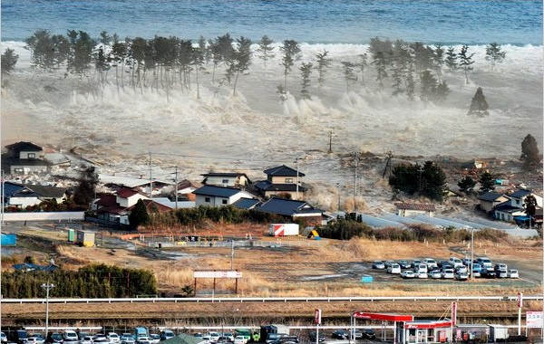
“BIGGEST” NATURAL disasters Tōhoku earthquake and tsunami, 2011
Often referred to in Japan, as the Great East Japan Earthquake, the Tōhoku quake was one that surpassed the record of the Great Kantō quake of 1923 in magnitude and destruction measuring a 9.0 in the moment magnitude scale and killing thousands of people across Japan! The quake was an undersea mega-thrust earthquake off the coast of Japan that occurred at 14:46 JST on Friday, 11th of March, 2011. It was the most powerful earthquake ever to hit Japan and the fifth most powerful quake in the world since the beginning of modern record keeping. The epicenter of the quake was approximately 43 miles east of the Oshika Peninsula of Tōhoku and the hypocenter at an underwater depth of approximately 19 miles. The quake triggered powerful tsunami waves that reached heights of up to 40.5 meters in Miyako in Tōhoku Iwate Prefecture. The quake was certainly the costliest natural disaster in world history, as the World Bank’s estimated total economic cost for the disaster was at US$235 billion.

Slide 28
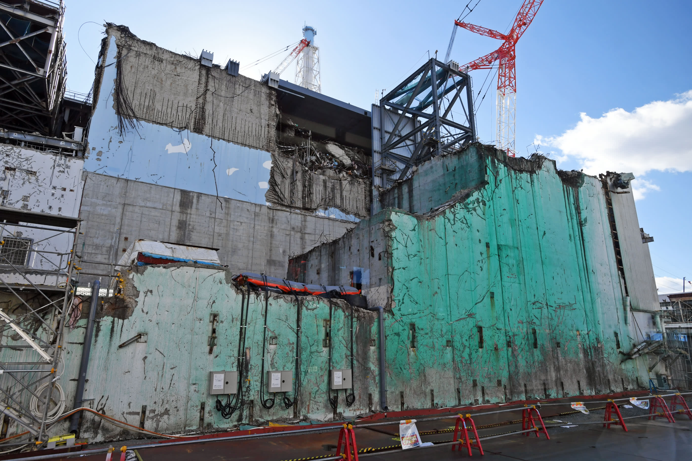
TECHNICAL DISASTERS Fukushima nuclear disaster
The six-reactor Fukushima Daiichi nuclear plant was badly damaged after the 11 March 2011 earthquake and tsunami knocked out cooling systems to reactors, leading to meltdowns and the release of radioactivity.
Tens of thousands of residents were evacuated from an exclusion zone around the plant as workers battled to bring reactors under control. Tepco declared the reactors stable in December 2011.

Slide 29
RESOURCES:
https://www.worldatlas.com/as/jp/where-is-japan.html
https://tradingeconomics.com/japan/population
http://www.worldometers.info/world-population/japan-population/
https://www.statravel.com/japan-climate.htm
https://www.japantimes.co.jp/news/2019/02/26/national/magnitude-7-8-quake-highly-likely-along-japan-trench-off-pacific-coast-within-30-years-panel-reports/#.XJjO9SgzaMo
https://www.elist10.com/top-10-natural-disasters-in-japanese-history/
https://en.wikipedia.org/wiki/List_of_earthquakes_in_Japan

